Slide 1

How Much Do The Neighborhoods Cost That Have the Features You Want?
Based on your choices, we can present to you the neighborhoods that are most likely to have the features you want, and the potential price for the neighborhood.

Slide 2
The Jones Family
Family of:
Two Adults
2 Children
1 Dog
Key features:
Large land area
Large Square Footage
At-least 3 Bedrooms

Slide 3
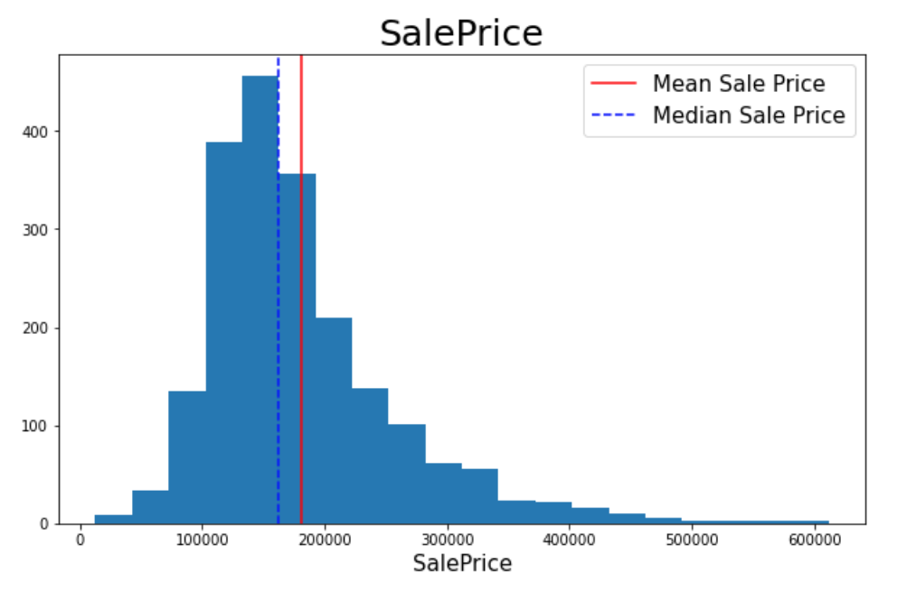
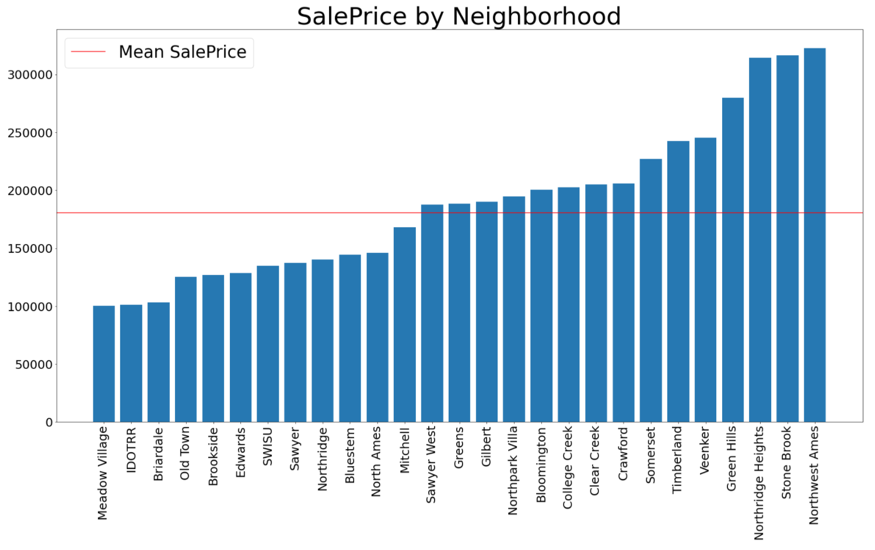
What is the Market Like as a Whole?

Slide 4
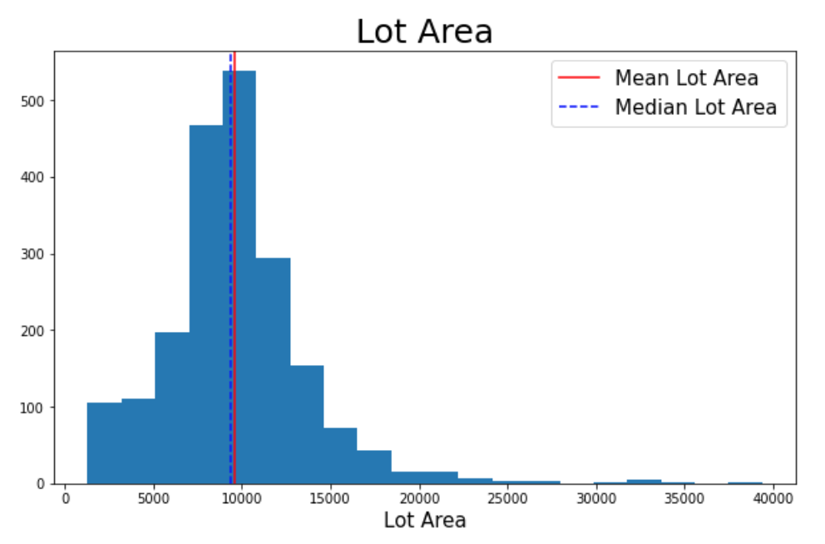
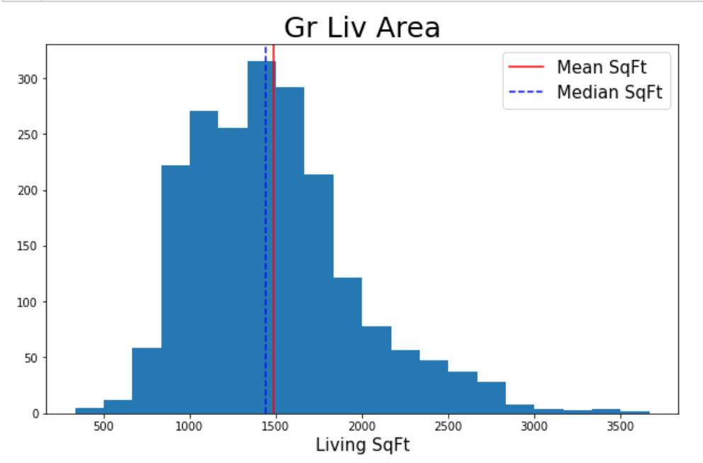
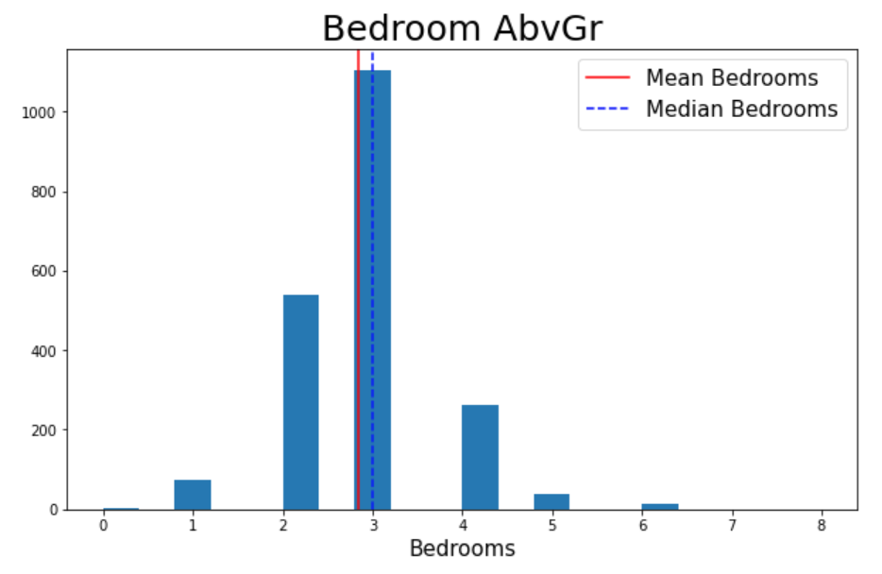
What is the Market Like as a Whole?

Slide 5
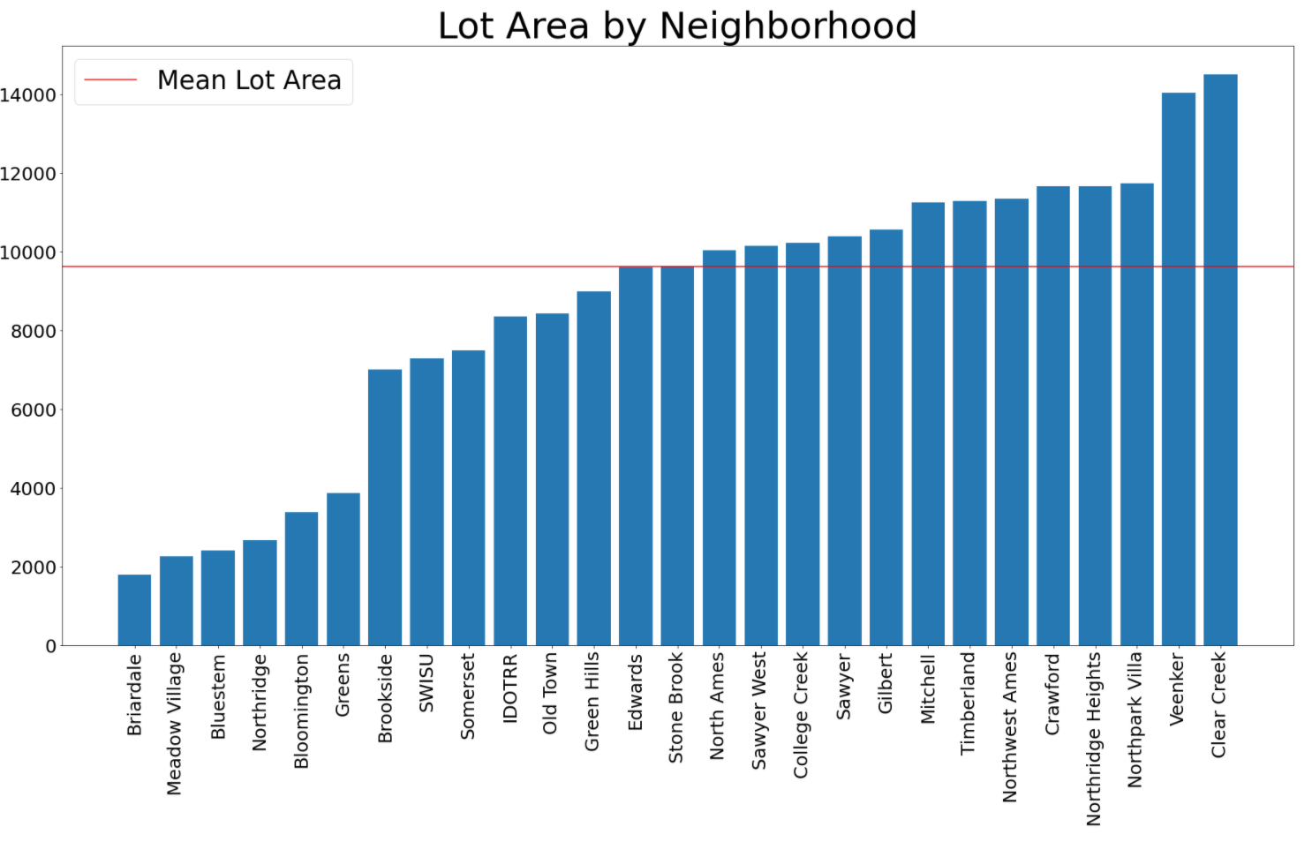
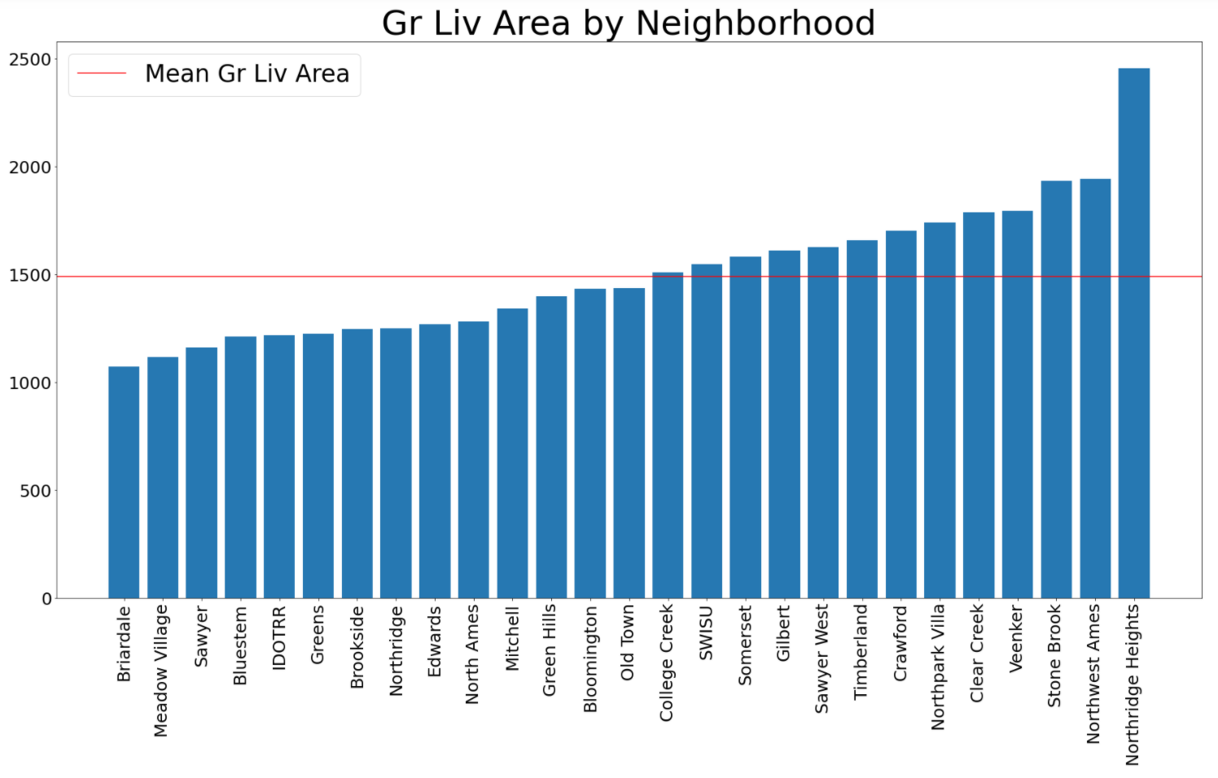
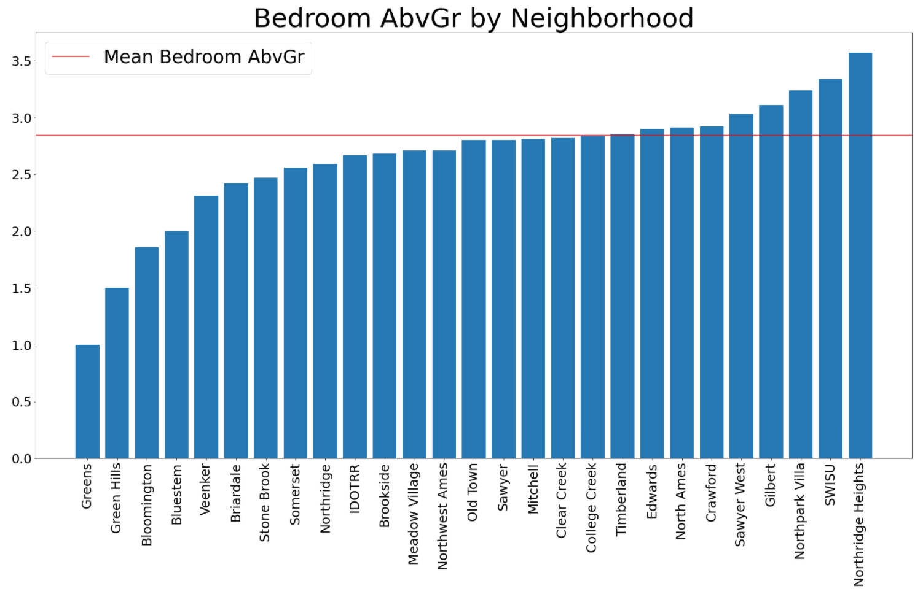
Presented are the three features plotted by the average per neighborhood.

Slide 6
Key Feature Score
To make it more easily understandable how the neighborhoods ranked based on the key features, I combined the three features into one feature. This feature is called “Key Features” score. On the following slide I have presented the rankings of neighborhoods based on this Key Feature Score.

Slide 7
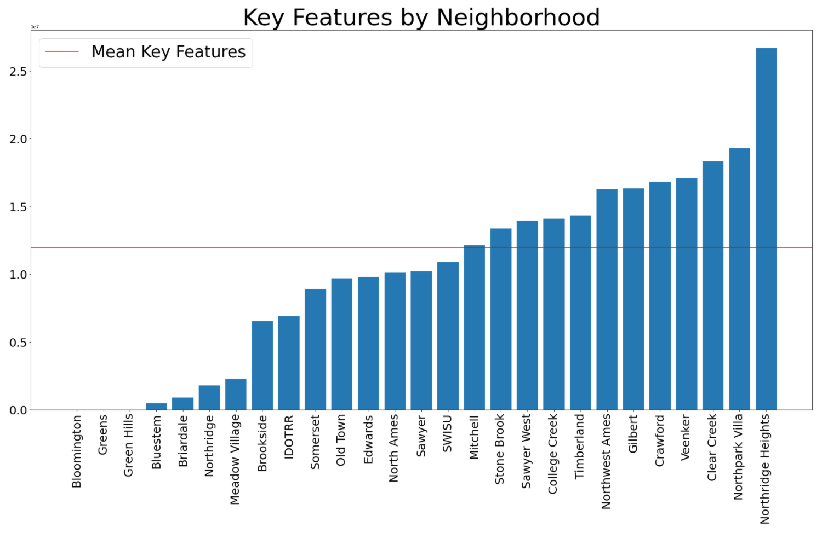
Combined

Slide 8
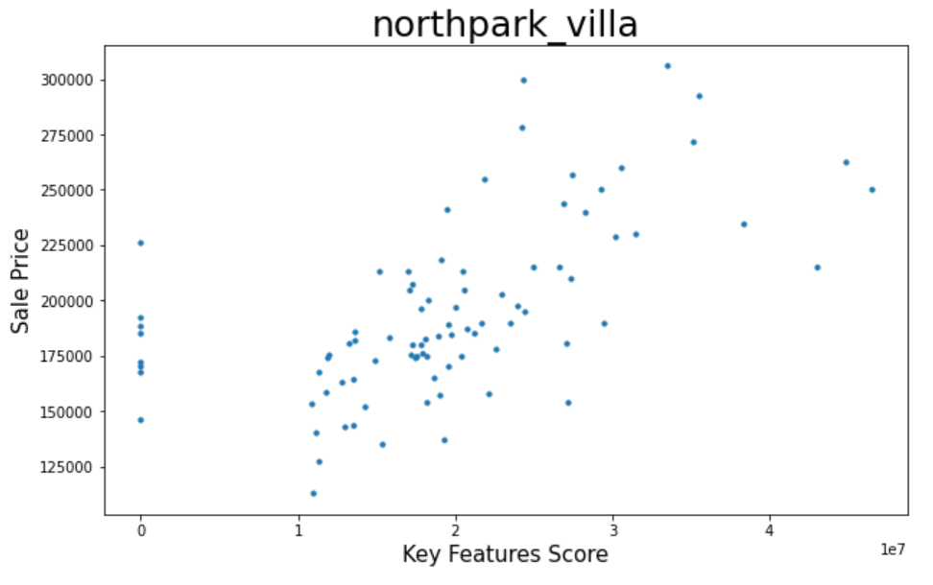
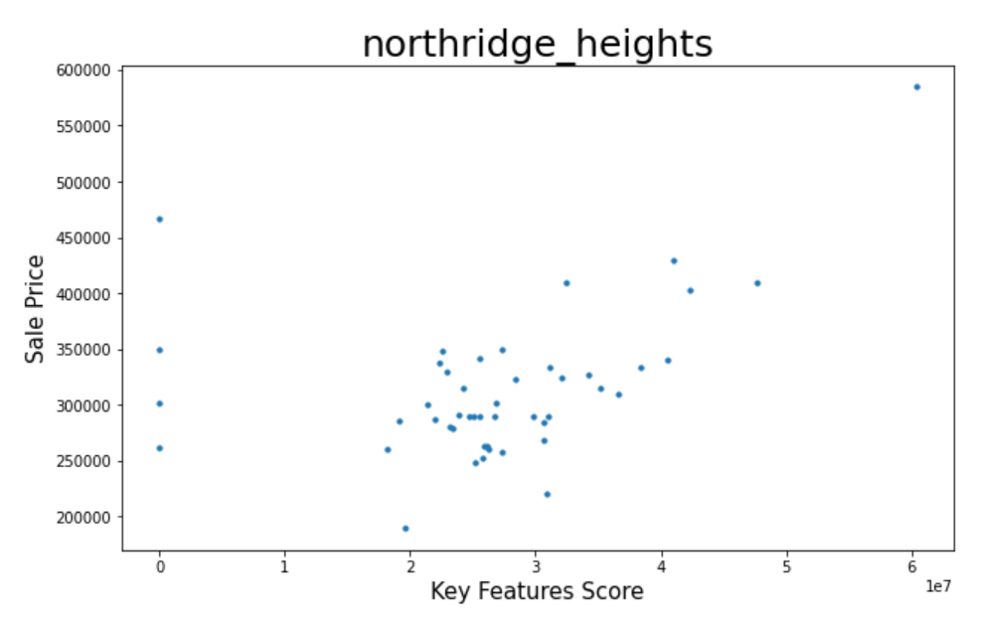
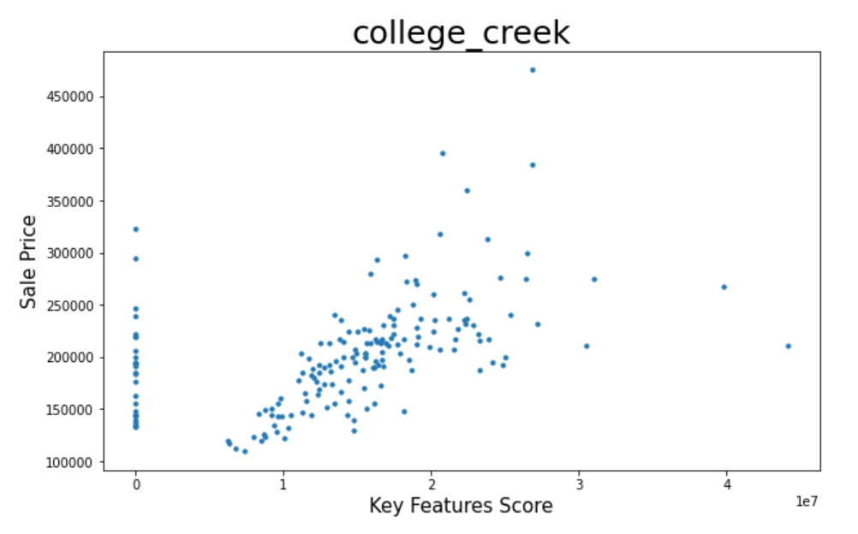

Slide 9
What will the Model Predict
Ultimately our model will produce a likely neighborhood and the associated mean price for the client based on the three features they provide to us. In the case of this client our model will infer that Northridge Heights is most likely the best fit, when we do not adjust for outliers, and present the mean price for the neighborhood.

